Slide 1
DESIGN OPTIMIZATION OF SUPER-ADHESIVE STRUCTURES
Supervisor – Dr. Kisor Kumar Sahu
Co-Supervisor – Dr. Sarah Fischer
Varre Rohit
18MM01012

Slide 2

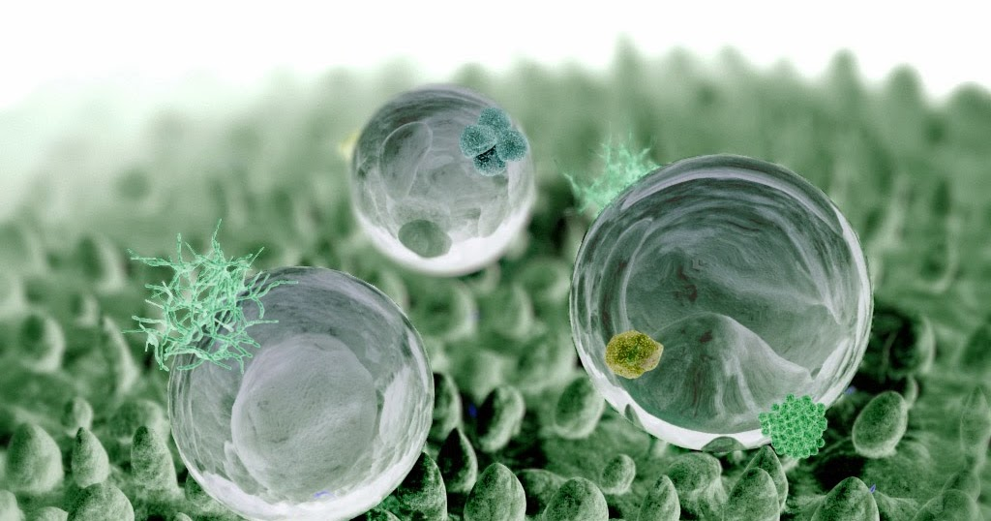
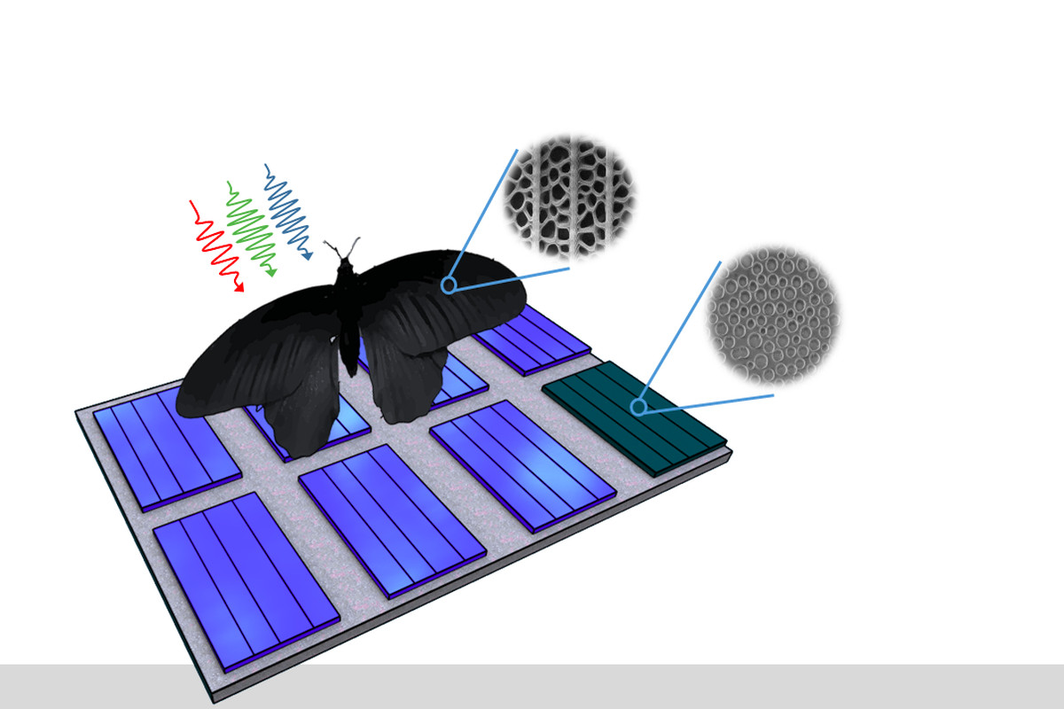

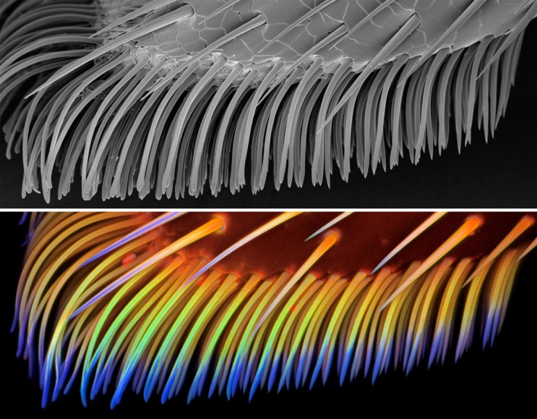
INTRODUCTION
Kingfisher & The Shinkansen Train
Lotus & hydrophobia
Butterflies & Solar Power
Super-Adhesion

Slide 3
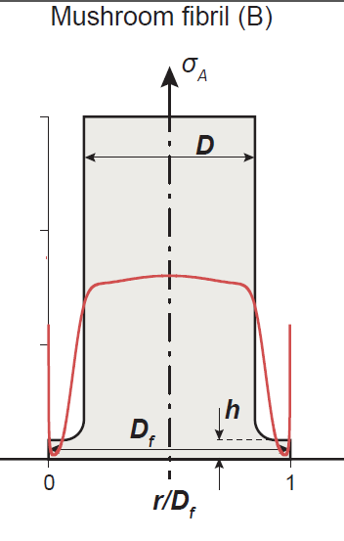
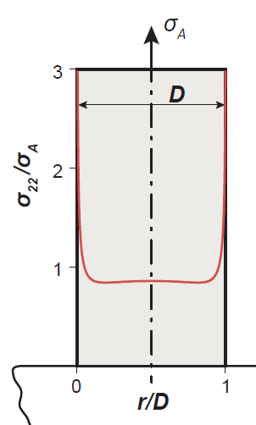
OBJECTIVE
The goals of the project are:
Predict the stress distribution of a biphase flat punch pillar.
Predict the detachment mechanism.
Steps:
1. Defining the simulation protocol
2. Data generation
3. Exploring the data
3. Train Machine learning models
4. Predict Detachment
Mushroom fibril
Flat punch

Slide 4
SIMULATION PROTOCOL
Experiments has shown that the stress distribution depends upon:
E=2MPa
Poisson‘s number = 0.49
Density of 965 kg/m³ (this is similar to Polydimethylsiloxane)
Define a 2 D geometry for the pillar of dimension 2 mm diameter and 4 mm height in contact with a rigid substrate
Define boundary conditions:
1. Symmetry axis
2. Boundary condition: fixed constraint which is the contact to the substrate
3. Apply a small displacement to the top of pillar - 100 µm
100 µm displacement

Slide 5
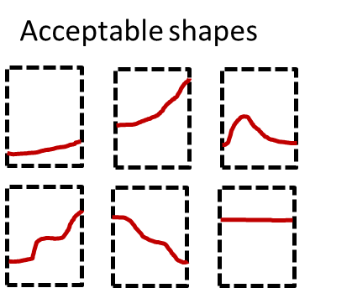
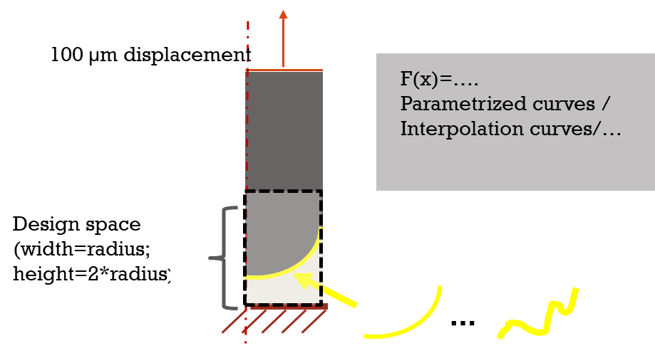
SIMULATION PROTOCOL
Not acceptable shapes
F(x) = 3rd order bezier curve
Non-continuous soft layer
Difficult to manufacture
Too low radius of curvature will cause irregularities

Slide 6
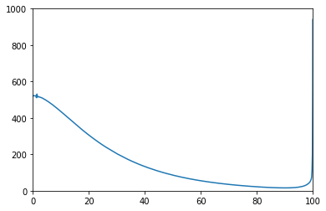
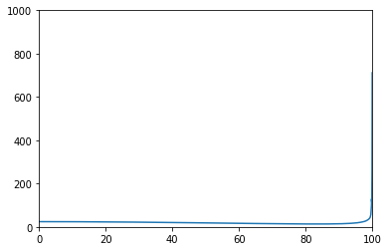
DATA GENERATION
Comsol software is used to generate data points with 1500 nodes.
Matlab is connected to Comsol for large scale data generation.
Bezier control points are generated at random to generate wide range of bezier curves.
59292 samples are generated.
Stress distribution indicator for high adhesion:
Reduction of magnitude of corner stress
Delay of crack formation from the edge

Slide 7
MACHINE LEARNING
Input Layer
1. Stress Prediction model:
Input layer consists of 1500 y coordinates to the respective x coordinate for the stress values.
Robust scaler is used to scale down and get rid of outliers in the data.
Loss - Mean squared error
Optimizer - Stochastic gradient descent
Regularizer - l2
Epochs - 50
Learning rate - 0.02
Momentum - 0.9
Batch size - 128
Activation - Leaky Relu
1500
2000
2000
2500
2000
1500
Prediction

Slide 8
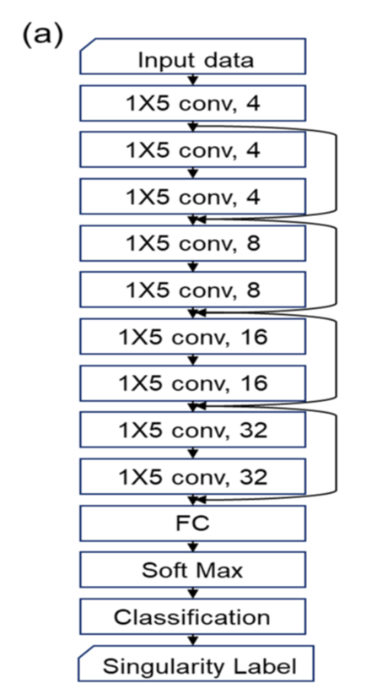
MACHINE LEARNING
2. Detachment Prediction model:
Input layer consists of the stress distribution images.
Multiple convolutional neural network layers employed in the model.
Loss – Categorical cross entropy
Metric - Accuracy
Optimizer - Adams
Epochs - 100
Learning rate - 0.01
Batch size - 128
Activation - Sigmoid

Slide 9
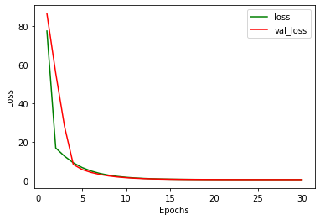
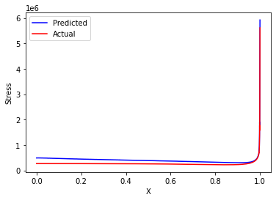
RESULTS
1. Stress Prediction model:

Slide 10
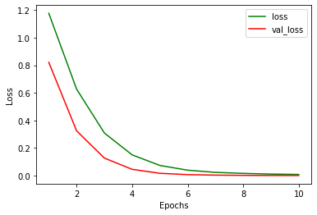
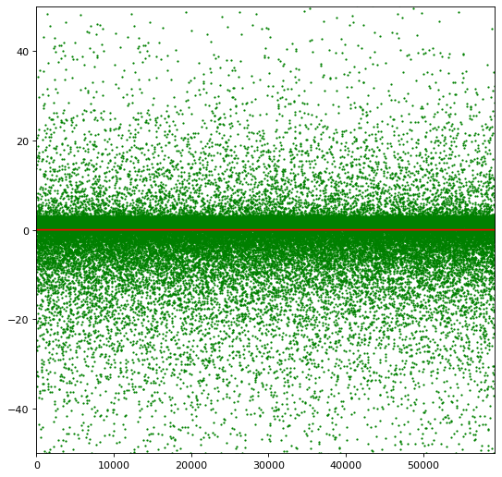
RESULTS
2. Detachment Prediction model:

Slide 11
CONCLUSION
In the stress prediction, even though the test loss is very low, there is a considerable amount of deviation, especially in the center of the pillar.
This might be due to the unique exponential behavior of the stress distribution.
An accuracy of 96.2 percent is observed in the detachment mechanism prediction.
Without performing any simulations, the detachment mechanism for any interface can be predicted with a decent accuracy.

Slide 12
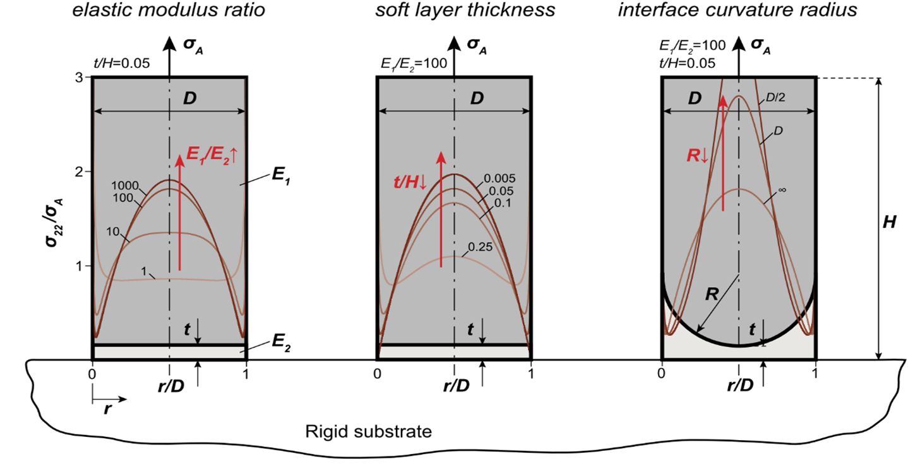
FUTURE SCOPE
Optimize the Machine learning algorithm by using different preprocessing techniques and model types to increase the accuracy on stress prediction.
Generalize the machine learning model for various materials.

Slide 13
THANK YOU!!!

